Slide 1

County Update
    Commissioners
    Dennis Stapleton
    Gary Merrell
    Ken O’Brien
Genoa Twp Business Association 5/1/2013

Slide 2
County Government
Created by Ohio Revised Code-Important
Average 1,000 employees( Sheriff -215; EMS-160)
      $44.9 Million payroll & 20.1 million in benefits
One of Top 50 Employers in central Ohio
(Chase: 9,800; Kroger’s: 2,200)
Commissioners oversee approximately 400 employees in 11 divisions.
Tim Hansley, County Administrator
Dawn Huston, Assistant County Administrator
Si Kille, Fiscal Services Director
Jennifer Walraven, Clerk to the Commissioners

Slide 4
Delaware Co. Directors
Department
Name
Administrative Services
Child Support
Communications Manager
Economic Development
Emergency Medical Services
9-1-1 Center
Emergency Management
Environmental Services
Facilities/Maintenance
Fiscal Services
Job & Family Services
Dawn Huston
Joyce Bowens
Teri Morgan
Gus Comstock
Mike Schuiling
Tim Hansley
Brian Gallagher
Tiffany Jenkins
Jack Prim/Jon Melvin
Si Kille
Shancie Jenkins

Slide 5
Accomplishments in 2011-12
* More deliberative approach to our meetings
* Work Sessions – twice monthly: Open free discussion
* Added Communications Manager & Fiscal Services Director
* Collaboration with Columbus 2020 for economic development
* Continue to improve relationship with local partners
Completed expansion of fiber in Rt. 23 corridor
Set aside $23 million in road funds & $3 million in “rainy day fund)

Slide 6
2013 General Fund Budget
$69.6 million General Fund
Bond Rating: S&P AAA (Only 2nd county in Ohio)
Major Sources of Revenue (2012)
  Sales Tax: $43,873,148
  Property Tax: $9,648,816
    Total property tax collected in county $368,916,465
  Conveyance Fees: $2,963,619
  Other Fees & Interest: $7,673,437

Slide 7
Delaware County Ohio:
Population in 2012: 182,000 (4% growth 2010-12)
( 57% increase since 2000; 160% since 1990)
Only 12 states with more counties than Ohio: (Largest: Cuyahoga 1.3M; Smallest :Vinton 13,000)
Unemployment 4.9% (Lowest in Ohio)
72,153 jobs in the county; 10,261 are retail jobs; 74% of all jobs are filled by outside residents 91,000 workers in the county and 76% work outside the county.

Slide 9
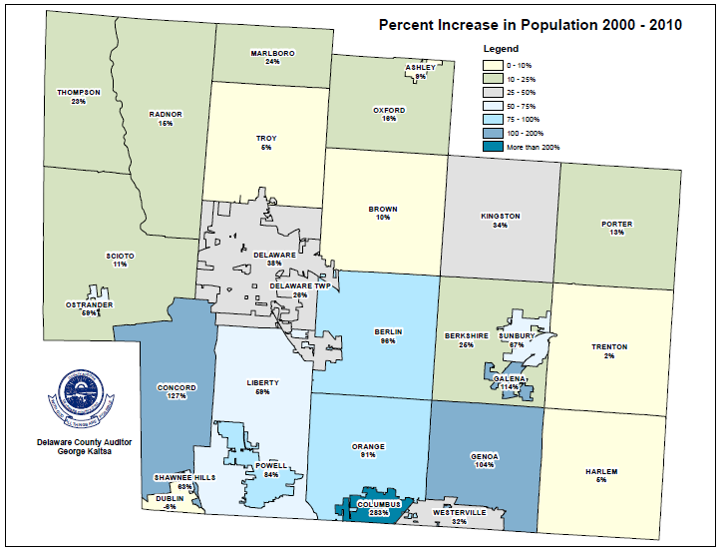

Slide 10
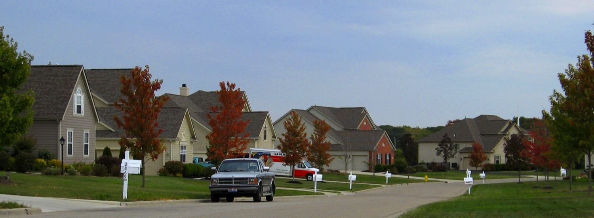
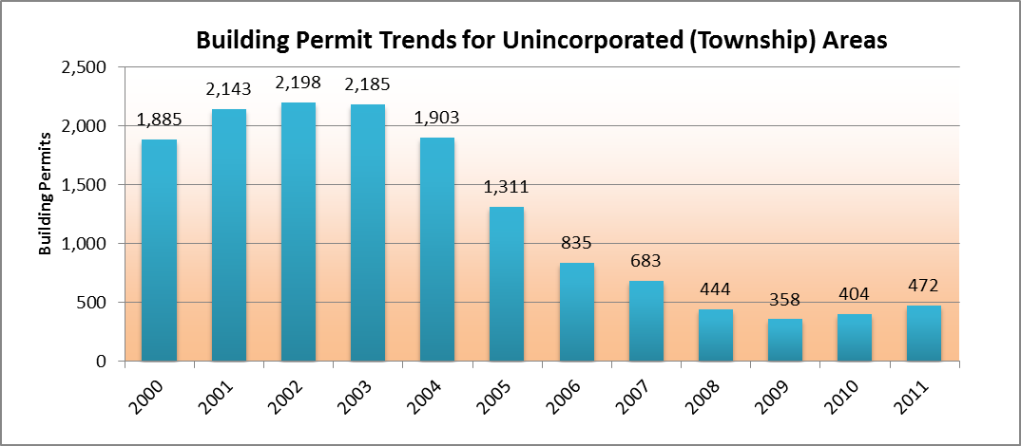
Housing Starts
Households: 62,760
Median Age: 37.4
Median Household Income; $88,060
Columbus2020: US Census, 2008-2010 average

Slide 11
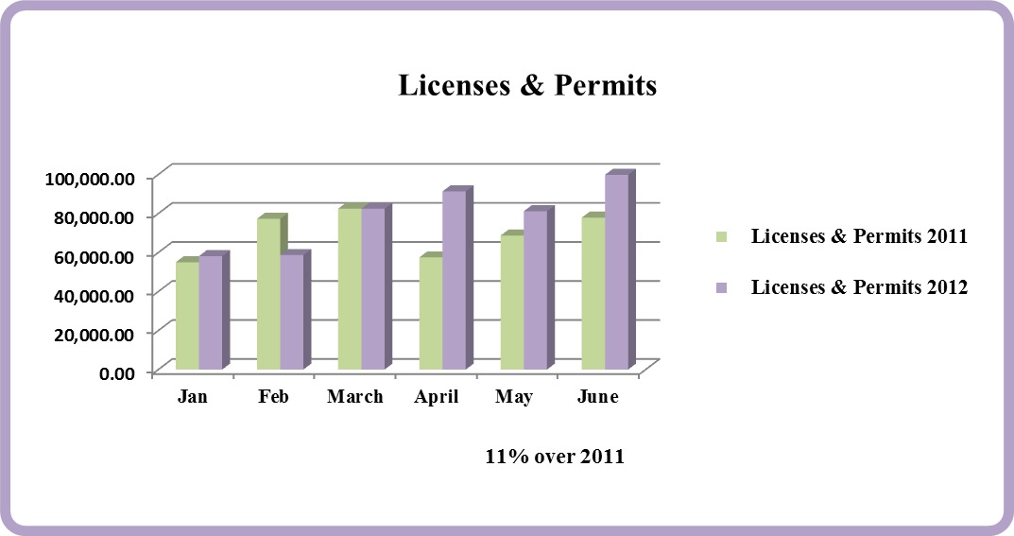
Licenses & Permits

Slide 12
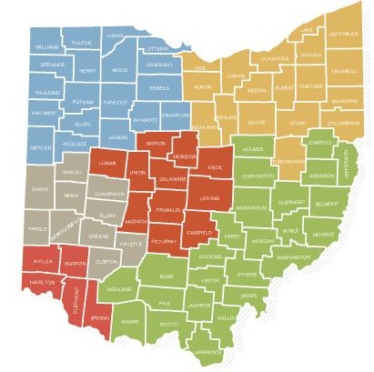
Economic Development
Columbus 2020! (One of six state partners of JobsOhio)
Retail gains-Cabela’s & Menards
I-71/US36 Update ???
Sawmill Pkwy
Sewer Master Plan
Notes:
American Howa: Moved facility from KY to Delaware –expanded to 70 jobs; RxScan moved from residential to Old State-kept them from moving to Dublin

Slide 13
Department Highlights
Regional Sewer District
  Delaware County owns and operates two regional wastewater treatment plants, seven package plants, twenty-five pump stations, and approximately 430 miles of gravity sewer, 33 miles of force main and 9,650 manholes
  Design capacity is approximately 17.3 million gallons per day (MGD). In 2011, the combined average flow through the plants was approximately 9 MGD or 53% of the overall capacity. Flow is up 1 MGD from last year due to more users and rainfall (up this year) infiltrating the system.

Slide 14

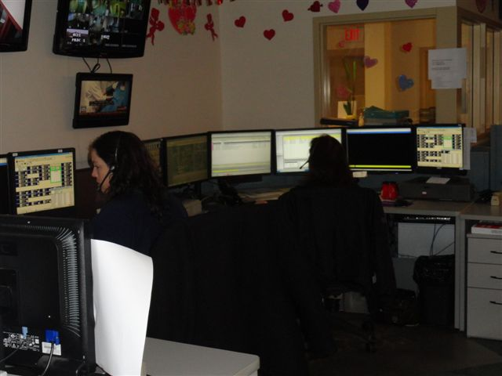
9-1-1 Center
Total calls taken :114,236 (71,454 administrative)
9-1-1 landline calls: 12,757
9-1-1 wireless calls: 30,025
Total dispatched
  Officer initiated
      64,667

Slide 15

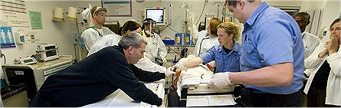

DCEMS
Emergency Medical Services
Ten Advanced Life Support Medical Transport Units
All Staffed with Three Paramedics 24/7/365, Plus Command Staff
Approximately 8,000 Patient Contacts Annually

Slide 16
Looking Ahead & Legislative agenda for CCAO Counties
Looking Ahead
Complete Facility Study
Sawmill Pkwy Discussion
EMS Billing & Changes to service
9-11 System Upgrade-$6 million
Legislative Agenda
Preserve adequate funding for county services
Expand shared Services Opportunities within county government-(phones/technology)
Reduce unfunded mandates-(elections, veterans services, indigent defense)

Slide 17

Questions

